Slide 1
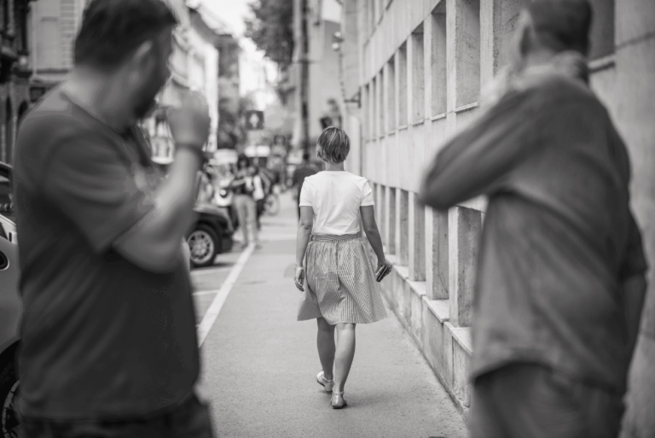

STATISTICAL STUDY WITH PLANNING ROUTES TO AVOID SEXUAL HARASSMENT IN MEDELLÍN.

Slide 2

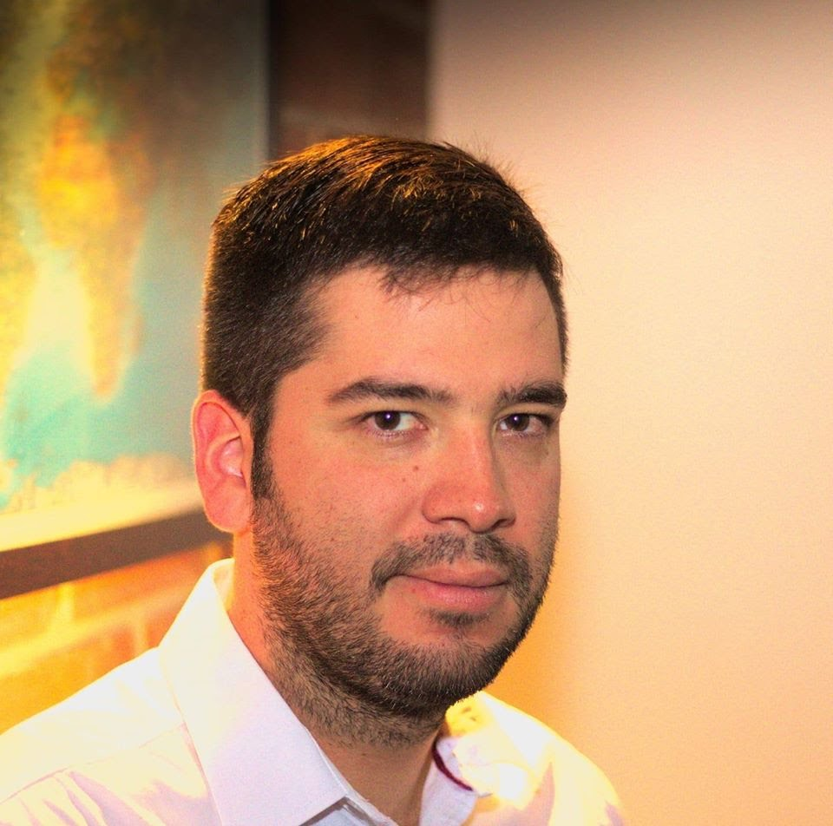
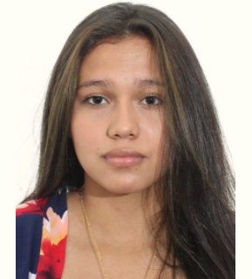
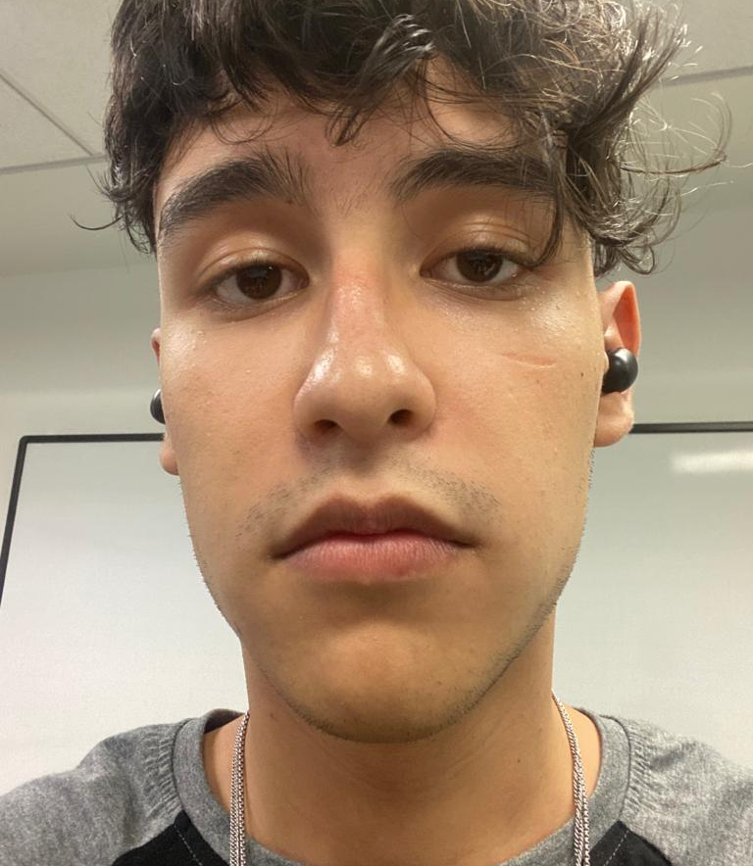


Team Presentation
Laura Danniela Zárate Guerrero.
Researcher and contributor.
Santiago Arias Higuita.
Designer and contributor.
Andrea Serna
Literature review
Mauricio
Toro
Data preparation
http://github.com/LauZar12/proyecto/

Slide 3
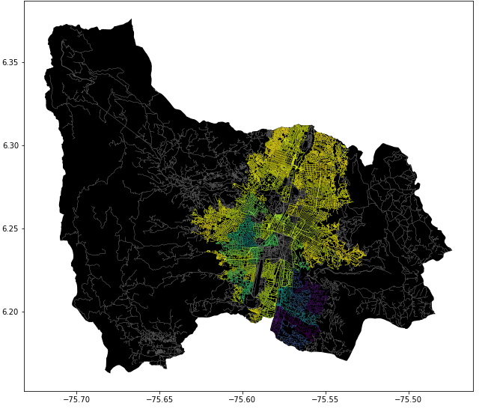
Problem Statement
Constrained Shortest Path Algorithm
Streets
of Medellín, Origin and Destination
Constrained
Shortest
Paths

Slide 4
First Algorithm
Seeker of the shortest path to go to a place.
r
Streets
of Medellín, Origin and Destination
Shortest path without exceeding a weighted-average risk of harassment r

Slide 5
Second Algorithm
Seeker of the path with less sexual harassment to go to a place.
d
Streets
of Medellín, Origin and Destination
Path with the lowest weighted-average risk of harassment without exceeding a distance d

Slide 6
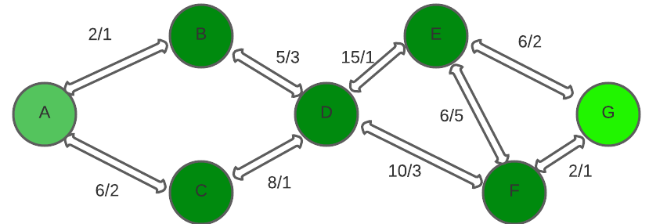

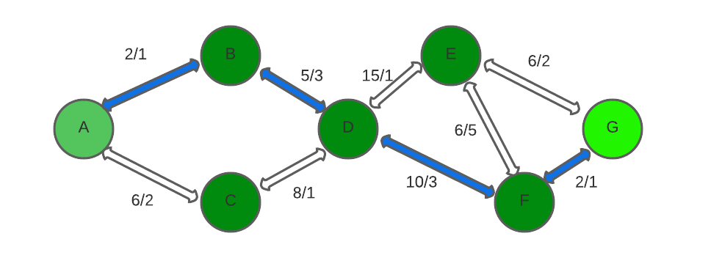
Algorithm Explanation
Fig 1
Fig 2
DIJKSTRA
Fig 3
We can observe a graph in fig1 containing two values ​​for each path from one node to another, that of the distance and that of the harassment. In fig2 we observe the operation of the Dijkstra algorithm, we can see how the algorithm search for each node the shortest path in its adjacent nodes and when it finds it, it adds them to the final path. This action is repeated until reaching the goal node. In fig 3 we can see the shortest path defined by the algorithm

Slide 7
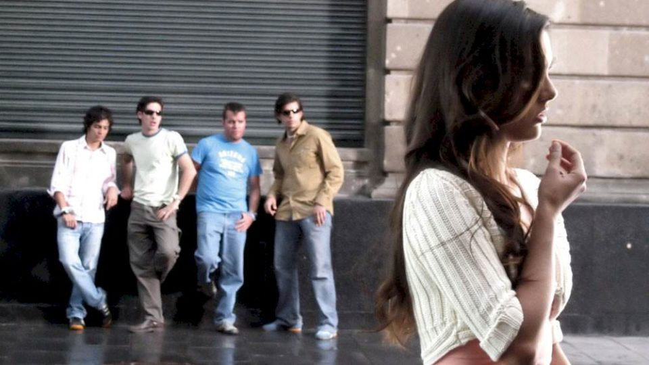
Algorithm Complexity
 | Time Complexity | Memory Complexity
Seeker of the shortest path to go to a place. | O((|V|+|E|) log |V|) | O(|V|²+|A|)
Seeker of the path with less sexual harassment to go to a place. | O(|V|+|E| log |V|) | O(|V|²+|A|)
On the table are the time and memory complexity of the algorithms where V is the number of nodes, E is the number of edges and A that is the number of aristos. The time complexity it´s given by using the Fibonacci heap min-priority, optimizing time complexity. And the memory complexity it is the one showed there because we used it for every single street (we don´t use a binary monticule or a balanced binary tree).

Slide 8
Keep this title
Complete this slide
For the third deliverable
Shortest Path Results
DO NOT use red color in the slides
Create the table in Powerpoint. Do not copy pixelated screenshots from the technical report please!
Origin | Destination | Shortest distance (meters) | Without exceeding a weighted-average risk of harassment
Universidad EAFIT | Universidad de Medellín | ?? | 0.84
Universidad de Antioquia | Universidad Nacional | ??? | 0.83
Universidad Nacional | Universidad Luis Amigó | ?? | 0.85
Shortest distance obtained without exceeding a weighted average risk of harassment r.
Explain the tables in your
own words
Font size should be of at least 22 points

Slide 9
Keep this title
Complete this slide
For the third deliverable
Lowest Risk Results
DO NOT use red color in the slides
Create the table in Powerpoint. Do not copy pixelated screenshots from the technical report please!
Origin | Destination | Weighted-average risk of harassment | Without exceeding a distance (meters)
Universidad EAFIT | Universidad de Medellín | ?? | 5000
Universidad de Antioquia | Universidad Nacional | ??? | 7000
Universidad Nacional | Universidad Luis Amigó | ?? | 6500
Lowest weighted-average risk of harassment obtained without exceeding a distance d.
Explain the tables in your
own words
Font size should be of at least 22 points

Slide 10






Complete this slide
For the third deliverable
Algorithm Execution Times
Keep this title
DO NOT use red color in the slides
Execution Times
2 hours 51 minutes
6 hours 51 minutes
8 hours 51 minutes
Font size should be of at least 22 points
Please, include measurement units, for instance, minutes, hours...

Slide 11

Complete this slide
For the third deliverable
Future Work Directions
Keep this title
DO NOT use red color in the slides
Please, name the courses in which you could continue working on this project
Probability
Optimization 1
Statistics 2
S & M 4
Other risk estimations
Biobjective
optimization
MV risk estimations
Traffic Estimation
Remove this
slide if you
study
Informatics Engineering
Please, name what you could do, in following courses, to improve this project
Font size should be of at least 22 points
You may add, remove or change some future work directions

Slide 12
Complete this slide
For the third deliverable
Future Work Directions
Keep this title
DO NOT use red color in the slides
Please, name the courses in which you could continue working on this project
Databases
Project 1
Software Eng.
Project 2
Add other variables
A Web Application
A Web Application
Include ML or VR
Remove this
slide if you
study
Mathematics Engineering
Please, name what you could do, in following courses, to improve this project
Font size should be of at least 22 points
You may add, remove or change some future work directions

Slide 13
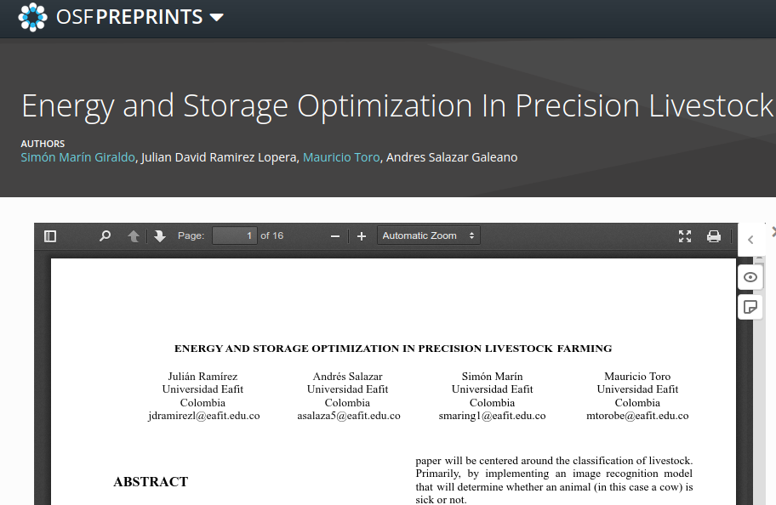
Complete this slide
For the third deliverable
Report Accepted on OSF.IO
Keep this title
DO NOT use red color in the slides
Remove this slide if you report was not submitted to OSF
This is a screenshot example of a previous report
This is a citation example of a previous report
Include the citation of the report in OSF PREPRINTS and link. No, not in OSF projects, but in OSF Preprints.
Julián Ramírez, Andrés Salazar, Simón Marín, Mauricio Toro. Energy and Storage Optimization in Precision Livestock Farming. Technical Report, Universidad EAFIT, 2021. https://doi.org/10.31219/osf.io/du8yt
Include a screenshot of your report published in osf.io and remove circle
Font size should be of at least 22 points
Include teaching assistant and professor among the authors, please

Slide 14
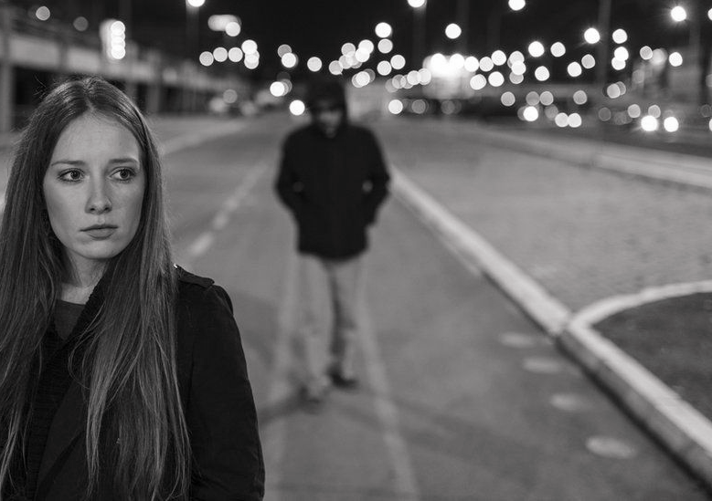
THANK YOU!.
You may change this photograph
Complete this slide
For the third deliverable
DO NOT use red color in the slides
Please do not forget the acknowledgements to your scholarship (if you have one) Otherwise, for who pays your tuition fee
Supported by
The first two authors were supported by Sapiencia grant, financed by Medellín municipality. All the authors would like to thank the "Vicerrectoría de Descubrimiento y Creación", of Universidad EAFIT, for their support on this research.
Font size should be of at least 22 points

